Slide 1



Java EE Basics
Servlets and JSP
JSF 2
Prime Faces
JSF
Prime Faces
Georgi Novakov
Develop Soft CEO
Software University
http://softuni.bg

Slide 2
Web Servers
Clients and servers communicate using the HyperText Transfer Protocol (HTTP)
Client and server establish TCP connection
Client requests content
Server responds with requested content
Client and server close connection (usually)
Web
client
(browser)
HTTP request
Web
server
HTTP response
(content)

Slide 3
Web Content
Web servers return content to clients
content: a sequence of bytes with an associated MIME (Multipurpose Internet Mail Extensions) type
Example MIME types
text/html HTML document
text/plain Unformatted text
application/postscript Postcript document
image/gif Binary image encoded in GIF format
image/jpeg Binary image encoded in JPEG
format

Slide 4
How Clients and Servers Use URLs
Example URL: http://www.softuni.bg:80/UsersApp/getuser?id=6
Clients use (http://www.softuni.bg:80) to infer:
What kind of server to contact (Web server)
Where the server is (www.softuni.bg)
What port it is listening on (80)
Servers use (/UsersApp/getuser?id=6) to:
Determine the application to access.
Determine the action to execute
Minimal suffix is “/”, which all servers expand to some default home page (e.g., index.html).

Slide 5
Request Methods
GET
whatever information is identified by the Request-URI
Can Get static content and data produced by a program
POST
Submit information to Web Server
Eg: posting to blog, submission of user form…
Information is included in message body
The actual function depends on request URI

Slide 6
Request Methods
HEAD
Servers response does not include message body
Useful for getting resource metadata without transferring the resource
Also useful for debugging , checking for validity, accessibility and modification
PUT
Requests a server store the enclosed data under the supplied Request URL.
Creates the resource if it does not create
Not useful for web publishing (FTP is preferred for security purposes)
DELETE
Removes the Web object
Needs to be carefully used for security reasons

Slide 7
Request Methods
TRACE method
Invokes a remote applictaion layer feedback of the request message
Useful for testing what is being received at the server
Also possible to forward to intermediaries for debugging purposes
OPTIONS
Requests information about communication options available to server

Slide 8
Session
A session is a period of time in which all activities happened within the period by the same web client are considered "related" (typically belong to the same application.)
Session Tracking – keeping track of users as they traverse from one web page (generated from a script) to another within a website (or within a web application).

Slide 9
How Session Works?
The first time a web client visits a server, the server sends a unique "session ID" to the web client for the client to keep.
Session ID is typically stored in the cookies.
The session ID is used by the server to identify the client.
Http Sessions have expiration time
The Server reserves space for each session and clients can save data per session
Typical example – User is put into HTTP session after successful login

Slide 10
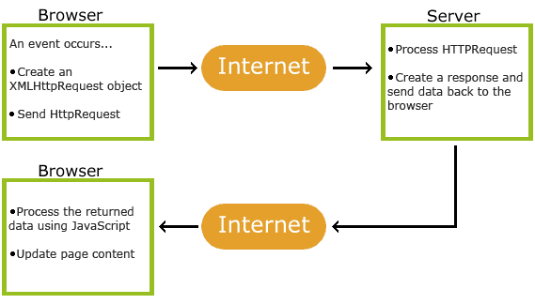
AJAX
AJAX = Asynchronous JavaScript and XML.
A technique for creating fast and dynamic web pages.
Submitting a form vs using Ajax

Slide 11
SERVLET FILTER
<filter>
<filter-name>AuthenticationFilter</filter-name>
<filter-class>bg.softuni.web.filter.AuthenticationFilter</filter-class>
</filter>
<filter-mapping>
<filter-name>AuthenticationFilter</filter-name>
<url-pattern>/page/*</url-pattern>
</filter-mapping>
public class AuthenticationFilter implements Filter, Serializable {
public void init(FilterConfig filterConfig) throws ServletException { }
public void destroy() { }
public void doFilter(ServletRequest request, ServletResponse response, FilterChain chain) throws IOException, ServletException {
HttpServletRequest httpRequest = (HttpServletRequest) request;
String requestedPath = httpRequest.getRequestURI().substring(httpRequest.getContextPath().length());
if (WebConstants.PATH_INDEX.equals(requestedPath)) {
chain.doFilter(request, response);
return;
}
if (WebConstants.PATH_LOGIN.equals(requestedPath) || WebConstants.PATH_FORGOTTEN_PASS.equals(requestedPath)) {
chain.doFilter(request, response);
return;
}
//check permission logic
……..
}
}

Slide 12
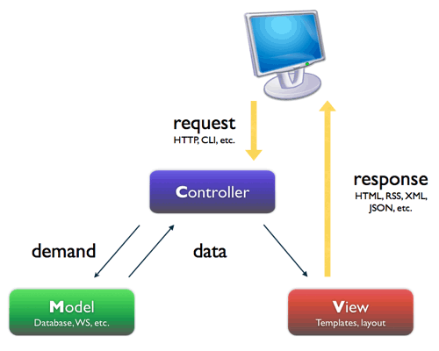
MVC
The model-view-controller (MVC) architecture provides a set of design patterns that help you separate the areas of concern involved in building and running a GUI or Web based application:
MODEL
encapsulates the business logic and persistence code for the application.
It should be as view-technology-agnostic as possible.
For example, the same model should be usable with a Swing application, a Struts app, or a JSF app.
VIEW
should display model objects and contain presentation logic only.
There should be no business logic or controller logic in the view.
CONTROLLER
acts as the mediator between the view and the model.
The controller talks to the model and delivers model objects to the view to display.
In an MVC architecture the controller always selects the next view.
.

Slide 13
JSF
JSF is a component of Java Enterprise Edition
A framework for developing Java Web applications based on JSP and Servlets
2 main parts:
API for presenting HTML components
Tag-libraries for building user interface

Slide 14

JSF History
2001 г. First version
2004 г. versions 1.0 and 1.1
2006 г. version 1.2 – finally a stable/usable version
2009 г. version 2.0

Slide 15
Advantages
Implement Model-View-Controller
Handle HTTP requests as events for a specific component
Allows separation of responsibilities in a team
By design and concept it allows to create reusable components. That will help to improve productivity and consistency.
Many ready to use components are available

Slide 16
advantages
Offers architecture for
Managing component’s state and data
Accept component’s events
User data validation
Everything can be extended and configured

Slide 17
Structure
A set of JSP pages
A set of backing beans
JSF configuration file(faces-config.xml)
Deployment descriptor (web.xml)
Internal validators, converters, components and event processors
JSF tag libraries

Slide 18
Component rendering model
Component writers can define the behavior of a component once but create multiple renderers, each of which defines a different way to render the component to the same client or to different clients.
Page authors and application developers can change the appearance of a component on the page by selecting the tag that represents the appropriate combination of component and renderer.
Notes:
The JavaServer Faces component architecture is designed such that the functionality of the components is defined by the component classes, whereas the component rendering can be defined by a separate renderer class. This design has several benefits, including the following:

Slide 19
Component rendering model
Each tag is connected to a Renderer, which defines its view
A render kit defines how component classes map to component tags that are appropriate for a particular client. The JSF implementation includes a standard HTML render kit for rendering to an HTML client.
Render kit include a set of Renderer classes for each component

Slide 20



Component rendering model Example
UISelectOne component has three different renderers:
One of them renders the component as a set of radio buttons
Another renders the component as a combo box
The third one renders the component as a list box
Similarly, a UICommand component can be rendered as a button or a hyperlink, using the h:commandButton or h:commandLink tag

Slide 21
CONVERSION MODEL
JSF conversion model provides an easy way for matching the data in the model and in the view
When a component is bound to an object, the application has two views of the component’s data:
The model view, in which data is represented as data types, such as int or long.
The presentation view, in which data is represented in a manner that can be read or modified by the user.
Example, a java.util.Date might be represented as a text string in the format mm/dd/yy or as a set of three text strings.
Example: UISelectBoolean provides checkbox and JSF allows this HTML component to be connected to a variable of type Boolean
Support for custom converters – implement javax.faces.convert.Converter
Notes:
A JavaServer Faces application can optionally associate a component with server-side object data. This object is a JavaBeans component, such as a managed bean. An application gets and sets the object data for a component by calling the appropriate object properties for that component.

Slide 22
EVENT AND LISTENER MODEL
Consists of two parts – Events and Listeners
The Event object defines the components, which initiated the event and carries information for the event itself
In order for the application to be notified for a specific event, it needs to provide a listener

Slide 23
EVENT AND LISTENER MODEL - APPLICATION EVENTS
tied to a particular application and are generated by a UIComponent
Tied to a particular application and are generated by a UIComponent
Action event - occurs when the user activates a component that implements javax.faces.component.ActionSource. These components include buttons and hyperlinks.
Value-change event - occurs when the user changes the value of a component represented by UIInput or one of its subclasses.
Value-change events are fired only if no validation errors are detected

Slide 24
EVENT AND LISTENER MODEL - APPLICATION EVENTS
tied to a particular application and are generated by a UIComponent
There are two ways to cause your application to react to action events or value-change events that are emitted by a standard component:
Implement an event listener class to handle the event and register the listener on the component by nesting either an f:valueChangeListener tag or an f:actionListener tag inside the component tag.
Implement a method of a managed bean to handle the event and refer to the method with a method expression from the appropriate attribute of the component’s tag

Slide 25
EVENT AND LISTENER MODEL - SYSTEM EVENTS
tied to a particular application and are generated by a UIComponent
Generated by an Object rather than a UIComponent.
Generated during the execution of an application at predefined times.
Applicable to the entire application rather than to a specific component.
Example: PostConstructApplicationEvent, PreDestroyApplicationEvent

Slide 26
EVENT AND LISTENER MODEL - DATA-MODEL EVENT
Occurs when a new row of a UIData component is selected.
Examples:
public class CustomSystemEventListener implements SystemEventListener {
@Override
public void processEvent(SystemEvent event) throws
AbortProcessingException {
if(event instanceof PostConstructApplicationEvent){
System.out.println("Application Started.
PostConstructApplicationEvent occurred!");
}
}
}
System event
//Define a method
public void handleEvent(ComponentSystemEvent event){
data="Hello World";
}
//Use above method
<f:event listener="#{user.handleEvent}" type="preRenderView" />
Application event

Slide 27
VALIDATION MODEL
Mechanism for validating the local data of editable components (such as text fields)
Custom validator
Implement a Validator interface that performs the validation.
Implement a managed bean method that performs the validation.
A set of predefined validators
<h:inputText id="nameField" required="true"/><h:message for="nameField"/>
<h:inputText ...>
<f:validateLength minimum="3"/>
</h:inputText>
<h:outputText value="#{PersonBean.age}">
<f:convertDateTime pattern="MMM dd, yyyy"/>
</h:outputText>

Slide 28
NAVIGATION MODEL
Static navigation – directly in commandLink or commandButton
Dynamic– with action methods that return String
<navigation-rule>
<from-view-id>/greeting.xhtml</from-view-id>
<navigation-case>
<from-outcome>success</from-outcome>
<to-view-id>/response.xhtml</to-view-id>
</navigation-case>
</navigation-rule>
//static
<h:commandButton id="submit" action="success" value="Submit" />
//dynamic
<h:commandButton id="submit" action="#{userNumberBean.getOrderStatus}" value="Submit" />
//no description in faces-config.xml
public String editAction() {
return "/page/role/createRole";
}

Slide 29
JSF managed (backing) beans
Look similar to regular Java Beans
Replace the Servlets and process the data from the JSP pages
Define methods for navigation between the pages
Have the following scopes
Request scope
Session scope
Application scope
View scope (JSF 2)
Can be accessed from other classes through FacesContext or through the user session(HttpSession object).

Slide 30
backing (managed) beans
Dynamic navigation
Validation, Conversion, Event Processing
Binding the current value of a HTML component
Binding a HTML component to UIComponent class for manipulating its state
Described in faces-confix.xml or just annotated with @ManagedBean

Slide 31
backing (managed) beans
@ManagedBean(name = "roleManagementBean")
@ViewScoped
public class RoleManagementBean extends BaseSearchBean<RoleModel> { …}
VS
<managed-bean>
<managed-bean-name>roleManagementBean</managed-bean-name>
<managed-bean-class>bg.softuni.jsf.RoleManagementBean</managed-bean-class>
<managed-bean-scope>view</managed-bean-scope>
</managed-bean>

Slide 32
JSF managed (backing) beans

Slide 33
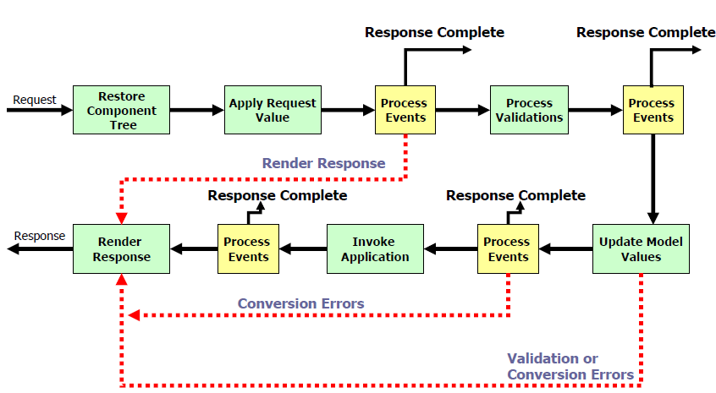
JSF – life cycle

Slide 34
JSF life cycle
Restore component tree
The controller examines the request and extracts the view ID, determined by the name of the JSP
If the view doesn't already exist, the JSF controller creates it otherwise creates it.
The view contains all the GUI components.
Apply Request Values
The purpose of this phase is for each component to retrieve its current state.
Component values are typically retrieved from the request parameters.
Process Validations
At this stage, each component will have its values validated against the application's validation rules.
Update Model
Updates the actual values of the server-side model --namely, by updating the properties of your backing beans.
Invoke Application
The JSF controller invokes the application to handle Form submissions.
The component values will have been converted, validated, and applied to the model objects, so you can now use them to execute the application's business logic.
Render Response
You display the view with all of its components in their current state. Basically, render page & send it back to client

Slide 35
Internationalization
Multi language support
All label are stored in properties files called ResourceBundles
Each ResourceBundle has a suffix, defining its language – messages_en.properties, messages_bg.properties, messages_de.properties
Defined in faces-config.xml and can be accessed in jsp files or Java classes

Slide 36
INTERNATIONALIZATION
application.properties
application_en.properties
application_bg.properties
application_fr.properties
<application>
<locale-config>
<default-locale>en</default-locale>
<supported-locale>bg</supported-locale>
</locale-config>
<resource-bundle>
<base-name>resources.application</base-name>
<var>msgs</var>
</resource-bundle>
</application>

Slide 37
INTERNATIONALIZATION
error.signup.name.required={0} is a required field
erorr.signup.name.short={0} must be at least {1} characters
erorr.signup.name.long={0} must be less than {1} characters
error.positive.number={0} must be positive number!
edit_button=Update
delete_button=Delete
create_button=Create
Login_button=Login
<p:commandButton ajax="false" action="#{loginBean.login}" styleClass="btn btn-info"
value="#{msgs.login_button}"
style="margin: 5% 0 5% 0;"
onclick="PF('blockUIWidget').block();"/>
<h:outputFormat value="#{error.positive.number}”>
<f:param value =“Age”/>
</h:outputFormat>

Slide 38
INTERNATIONALIZATION
public class MessageUtils {
private final static String RESOURCE_BUNDLE_FILE = "resources.application";
private final static ResourceBundle RESOURCE_BUNDLE = getBundle();
public static String getMessage(String aKey) {
return RESOURCE_BUNDLE.getString(aKey);
}
/**
* @param params positional parameters to be inserted in "{0}, {1}, etc."
*/
public static String getMessage(String aKey, Object... params) {
return MessageFormat.format(RESOURCE_BUNDLE.getString(aKey), params);
}
public static void addMessage(String clientId, FacesMessage msg) {
FacesContext.getCurrentInstance().addMessage(clientId, msg);
}
}

Slide 39
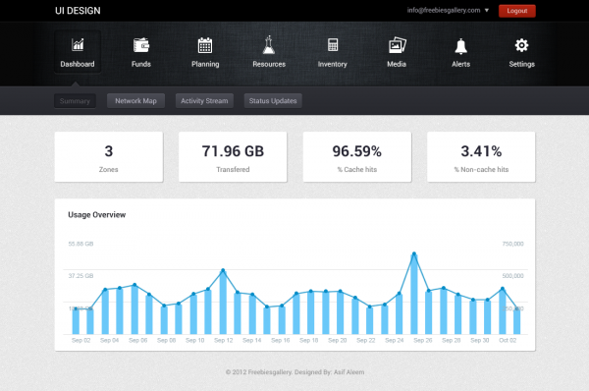
Facelets
Used for templating
Included in JSF 2
Rely on XHTML code
Using tag library <ui:…>
One main template XHTML
page and different “client” XHTML pages.

Slide 40
Facelets

Slide 41
Facelets

Slide 42
JSF 2 – What is new
Default Facelets
Working with XHTML code
Improvements in:
Using annotations instead of faces-config.xml
Better work with Ajax requests
Types parametrization
New ViewScope for managed beans.

Slide 43

Open source UI component, which adds various predefined components to JSF2
Alternative to Richfaces, MyFaces, ICEfaces
Complies with the JSF component model and is easily extendable
Well documented
http://www.primefaces.org
http://www.primefaces.org/showcase/

Slide 44
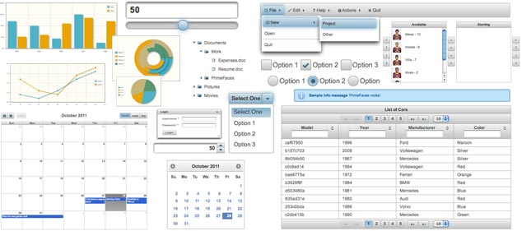
Primefaces –popular components
DataTable
File
Drag and Drop
Autocomplete
Accordion
Dialogs
Charts

Slide 45
JSF application step by step
Description in web.xml
<servlet> <display-name>FacesServlet</display-name> <servlet-name>FacesServlet</servlet-name> <servlet-class>javax.faces.webapp.FacesServlet</servlet-class> <load-on-startup>1</load-on-startup> </servlet> <servlet-mapping> <servlet-name>FacesServlet</servlet-name> <url-pattern>/faces/*</url-pattern> </servlet-mapping>

Slide 46
JSF application step by step
Creating the JSF pages using the main tags and html components
Connect the web page with a backing bean
<%@ taglib uri="http://java.sun.com/jsf/html" prefix="h" %> <%@ taglib uri="http://java.sun.com/jsf/core" prefix="f" %>
<h:inputText size="40" id="nameField" value="#{PersonBean.name}"/>

Slide 47
JSF application step by step
Define navigation between pages
Define rules in faces-config.xml
<h:commandButton action="greeting" value="#{txt.button_text}" />
<navigation-rule> <from-view-id>/inputname.jsp</from-view-id> <navigation-case> <from-outcome>greeting</from-outcome> <to-view-id>/greetings.jsp</to-view-id> </navigation-case> </navigation-rule>

Slide 48
JSF application step by step
Build backing (managed) beans and declare them in faces-config.xml
package bg.softuni.jsf; public class PersonBean { private String name; public String getName() { return name; } public void setName(String name) { this.name = name; } }
<managed-bean> <managed-bean-name>PersonBean</managed-bean-name> <managed-bean-class>bg.softuni.jsf.PersonBean</managed-bean-class> <managed-bean-scope>request</managed-bean-scope> </managed-bean>

Slide 49






Free Trainings @ Software University
Software University Foundation – softuni.org
Software University – High-Quality Education, Profession and Job for Software Developers
softuni.bg
Software University @ Facebook
facebook.com/SoftwareUniversity
Software University @ YouTube
youtube.com/SoftwareUniversity
Software University Forums – forum.softuni.bg

